Slide 1

Fundamentals of Management
SESSION 2
BY
Azar Ejaz Ateeq

Slide 2
Chapter 1
Managers and You in the Workplace

Slide 3
Henry Mintzberg’s Managerial Roles
Interpersonal
Figurehead
Leader
Liaison
Informational
Monitor
Disseminator
Spokesperson
Decisional
Entrepreneur
Disturbance handler
Resource allocator
Negotiator
Reference: Management, 14th Edition by Stephen P. Robbins,

Slide 4
Interpersonal Roles
Involves developing and maintaining positive relationship with others
Figurehead:
Symbolic head; obliged to perform a number of routine duties of a legal or social nature
Leader:
Responsible for the motivation of subordinates; responsible for staffing, training and associated duties.
Liaison:
Maintain self-developed network of outside contacts and informers who provide information and favors.
Reference: Management, 14th Edition by Stephen P. Robbins

Slide 5
Informational Roles
Pertains to receiving and transmitting information to other organizational units.
Monitor:
Seeks and receives wide variety of internal and external information.
Disseminator:
Transmits information received from outsiders or from subordinated to member of the organization.
Spokesperson:
Transmits information to outsiders on organization’s plan, policies, actions, results, etc
Reference: Management, 14th Edition by Stephen P. Robbins

Slide 6
Decisional Roles
Involves making significant decisions that affect the organization
Disturbance handler:
Responsible for corrective action when organization faces important unexpected disturbances
Resource Allocator:
Responsible for allocation of organizational resources of all kinds making or approving all significant organizational decision
Negotiator:
Responsible for repressing the organization at major negotiations
Entrepreneur:
Search organization and its environment for opportunities and initiates “improvement project”
Reference: Management, 14th Edition by Stephen P. Robbins

Slide 7
Management Skills
Technical Skills
Job-specific knowledge and techniques needed to proficiently perform work tasks
Interpersonal /Human Skills
The ability to work well with other people individually and in a group
Conceptual Skills
The ability to think and to conceptualize about abstract and complex situations
Reference: Management, 14th Edition by Stephen P. Robbins

Slide 8
HOW is the Manager’s job changing?
Focus on the Customer
Focus on Technology
Focus on Social Media
Focus on Innovation
Focus on Sustainability
Focus on the Employee
Reference: Management, 14th Edition by Stephen P. Robbins

Slide 9
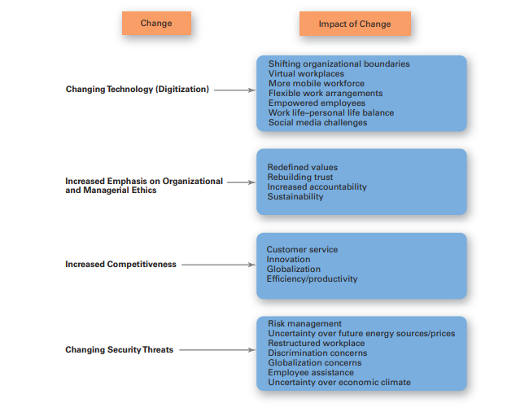
Changes Facing Managers
Reference: Management, 14th Edition by Stephen P. Robbins

Slide 10
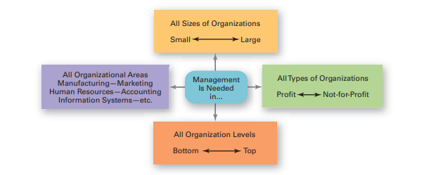
WHY study Management?
Universality of Management
The reality that management is needed in all types and sizes of organizations, at all organizational levels, in all organizational areas, and in organizations no matter where located.
Reference: Management, 14th Edition by Stephen P. Robbins

Slide 11
THANK YOU

